Slide 1
Launch and Expansion Strategy for Codex
Saranya Selvaraj
25-06-2023

Slide 2
Agenda
Energy Drink Market in India
Demographic Insights
Consumption habits
Consumer Preferences
Product Awareness & perception
Product Experience
Competitive Analysis
Marketing and Packaging
Pricing and Availability
Product Vision
Market Strategy
SWOT Analysis
Target Audience & Brand Positioning
4Ps for Codex and its variants
Launch Strategy
Endorsement Strategy
Road ahead

Slide 3
Energy Drink Market in India

Slide 4
Overall Indian market size and trend
2031
$ 4.2 Bn
5.6% CAGR
2023
$ 2.6 Bn
Energy Boosters Need
Positive preference – young population
Source : Growth Market Reports: India Energy Drink Market : Report Link

Slide 5
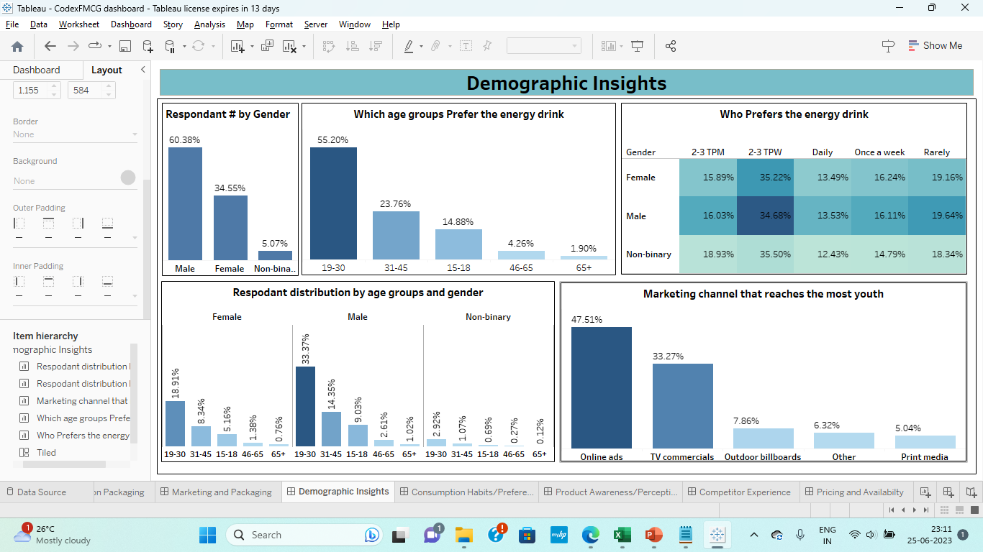
Demographic Insights
On an average there are 60% male respondents across each age, city and tier category
Majority Male prefer the Energy drink
Age group between 19-30(More than 50% overall) prefer to drink the Energy drink.
Mostly youths are aware of the product though online ads.

Slide 6
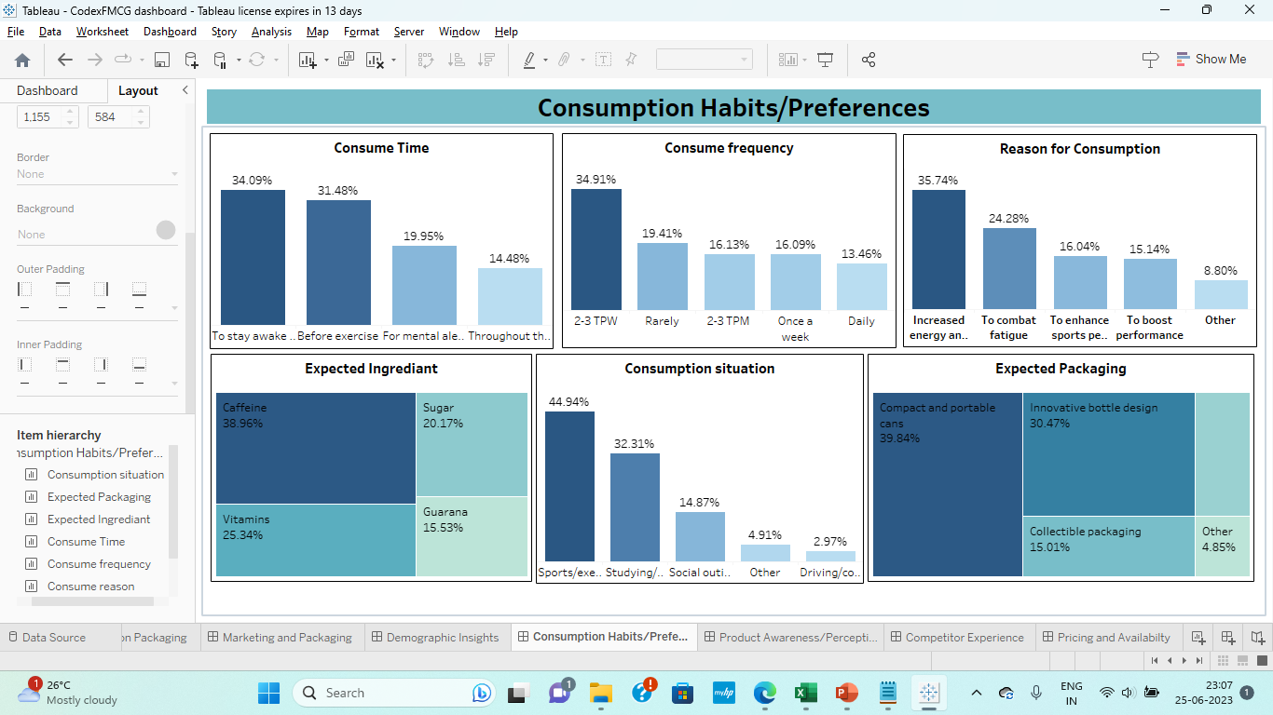
Consumption Habits/Preferences
Mostly Consumer Consume the drink to stay awake during the study time and working hours followed by consuming it before exercise.
The broad categories of consumption frequency, less frequent (rarely & 2- times a month) and frequently (2-3 times a week) are close to 35% across genders, age and city tier groups
There is no influence of consumption time & consumption reason
The majority say that they consume energy drinks before exercise followed by to study/stay awake, across age , gender and city tiers (for city tier it swaps but still in top two)
Men and women drink for increased energy and focus followed by combat fatigue.
Respondents expect caffeine followed by vitamins and Sugar .
In general majority thinks these drinks are harmful for health and expect healthy ingredients

Slide 7
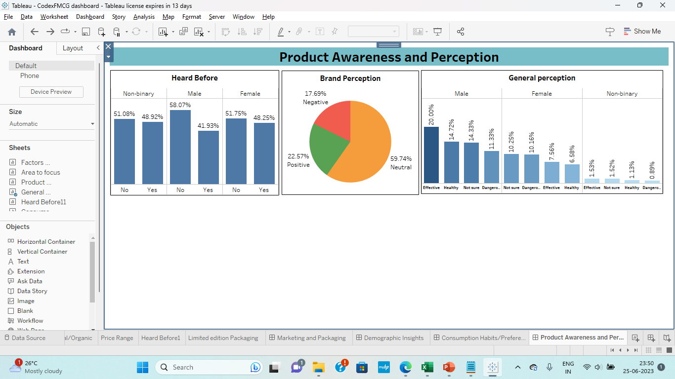
Product Awareness/Perception
1.Brand awareness is low with less than 50%, interestingly across all categories, female and non-binary seems to be more aware than males (like 49% awareness, which is significantly higher than males).
2. The Brand perception in general is neutral (which can be interpreted as indifference too) and positive is slightly higher than negative perception, they generally feel it is either effective or neutral
3. The general perception towards energy drinks has interesting insights. Overall female respondents seems to feel either it is dangerous or were not sure and same with the broad category of respondents in above 30+ years in age irrespective of gender or any other category.
4. The age group below 30 years and male respondent have a positive perception towards the energy drinks. They think either they are effective or even healthy.

Slide 8
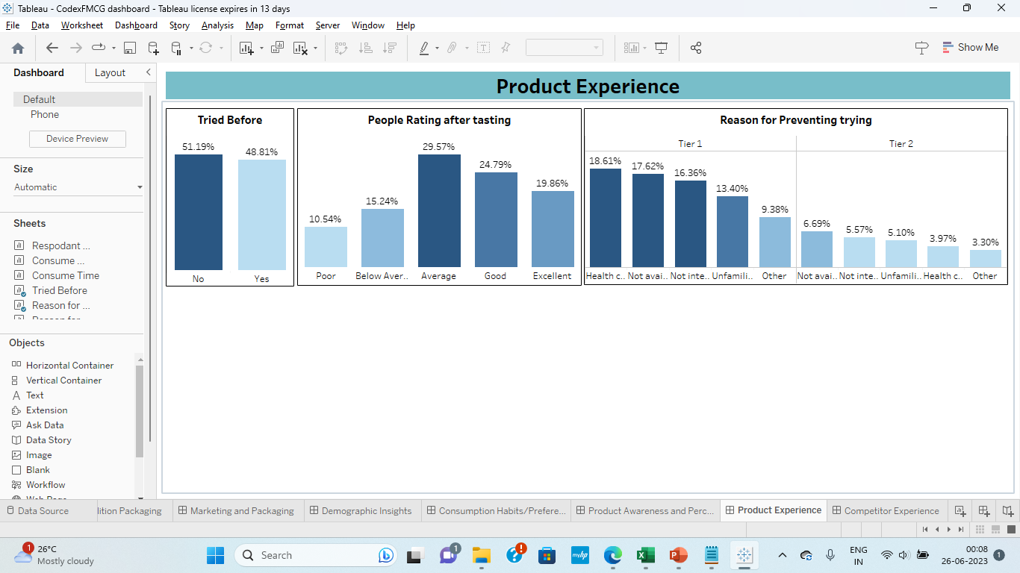
Product Experience
1.Overall people have not tried our brand and it is worse for tier two cities.
2. After the taste test (assumption) the overall perception seems Average followed by Good and Excellent. This is a positive response for the product's taste.
3. The reasons for not trying are different between tier 1 and 2 cities, for tier 1 its health concerns followed by non availability, for tier 2 its non availability first followed by no interest in this type of drinks. Overall its non availability respectively and health concerns

Slide 9
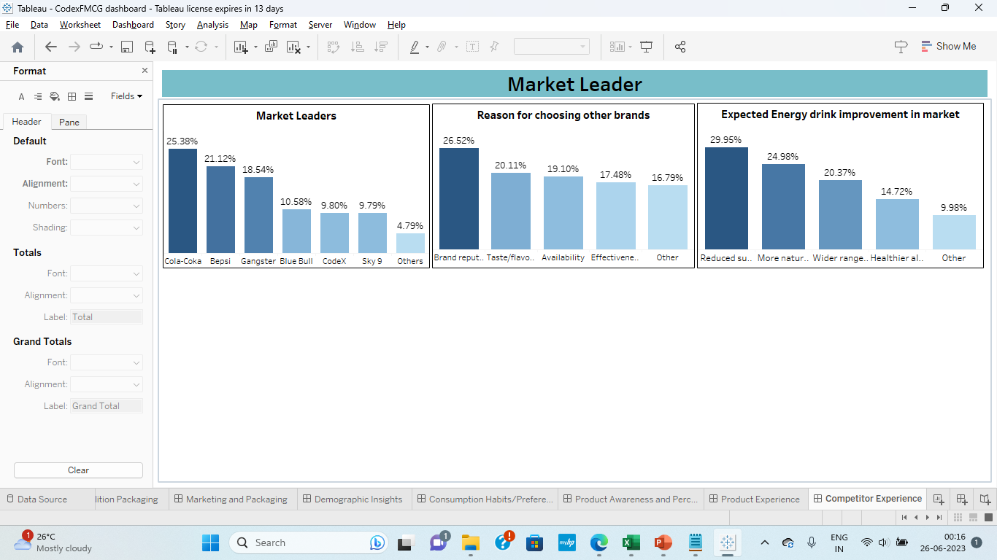
Market Leader
1.The most popular brands are Colo-coka, Bepsi and Gangster irrespective of categories.
2.Reason for choosing a drink is brand reputation followed by taste & flavors
3.Improvements preferred are reduced sugar content, more natural flavors and wide range of flavours

Slide 10
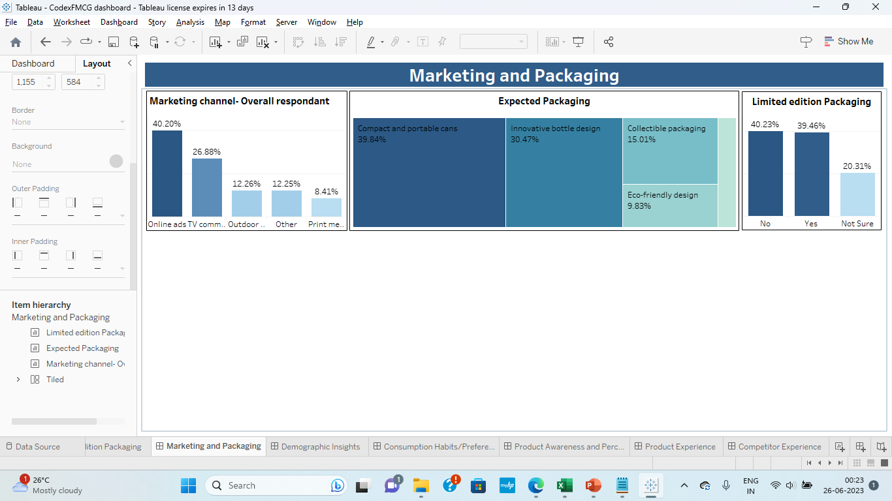
Marketing and Packaging
1. The top channels are online and TV commercials. The younger age groups prefer online followed by TV commercials.
2. “Compact and portable cans” followed by “innovative bottle design” are the preferred package designs.
3. The respondents are equally divided between preferring limited edition packaging.

Slide 11
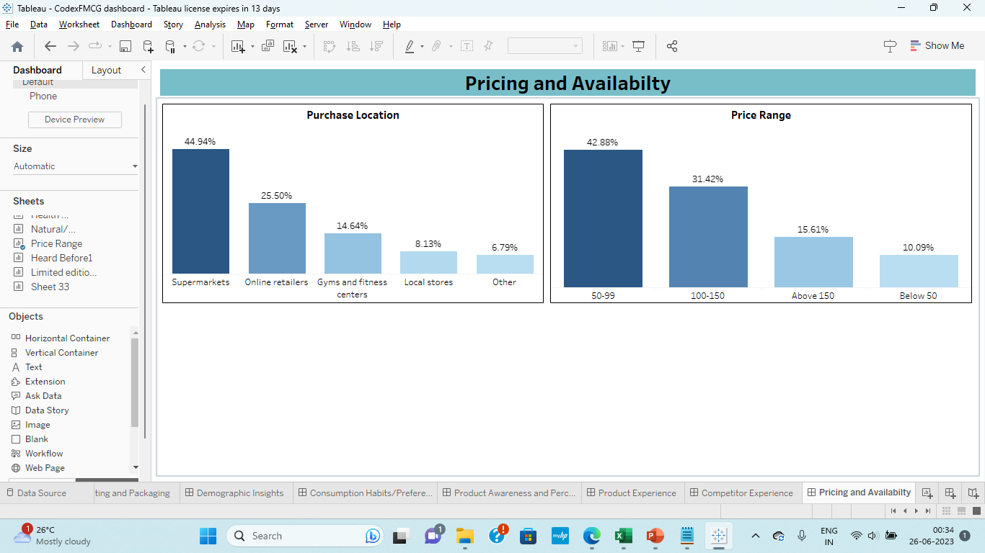
Pricing and Availability
1. The preferred price point for majority younger respondents is between 50 - 99 while the seniors are open to buy the drink for higher price.
2. Super markets followed by online retailers are the preferred places to purchase the energy drinks,

Slide 12
Drink for the Dreamers!

Slide 13


Vision To energize people to achieve their dreams
Codex – Drink for the Dreamers !
Marketing Goal
To reach 12% market share in terms of sales in 12 months of launch

Slide 14
Marketing Strategy

Slide 15
SWOT Analysis
Strength
Weakness
Likeable Taste
1. Brand Perception
2. Non availability
3. Weak Brand recall
Opportunity
Threat
1. Category level Lower frequency of consumption
2. Expecting Healthy options
3. Young Male consumers are positive about energy drinks
1. Health concerns
2. Strong incumbent competition
3. Women finding it harmful

Slide 16
Target & Brand Positioning
Product | Target Audience | Positioning
CodeX Regular Variant | Below 30 years | Dream Big
CodeX Hi Caffeine Variant | 31 – 65 years | Get more work done
CodeX Healthy Variant | Above 30+ | Age is just a number
CodeX Sugar free Variant | All | Carefree, Energy Overload
CodeX Tasty Variant | All | Have an adventure

Slide 17
Proposed Marketing Mix
Product | Price | Promotion | Place
CodeX Regular Variant | Regular (INR 50) | Online ads (Sports, Videos/Games/Influencers), Sport Arena Ads | Supermarket, Online retailers, Cafeterias, Sports Arena
CodeX Healthy Variant | High Premium (INR 100) | Newspaper Ads, TV commercials | Supermarket, Online retailers, Jogger park, Golf Courses, Mom & Pop Stores.
CodeX Hi Caffeine Variant | High Premium (INR 100) | Online Ads, Highway billboards | Supermarket, Online retailers, Company Cafeterias, Golf Courses
CodeX Tasty Variant | Regular or lower (INR 50) | Online ads, TV commercials, Billboards | Supermarket, Online retailers, Mom & Pop stores
CodeX Sugar free Variant | Premium(INR 80) | TV commercials, Billboards | Supermarket, Online retailers, Jogger park, Golf Courses, Mom & Pop Stores.

Slide 18
Launch Strategy

Slide 19

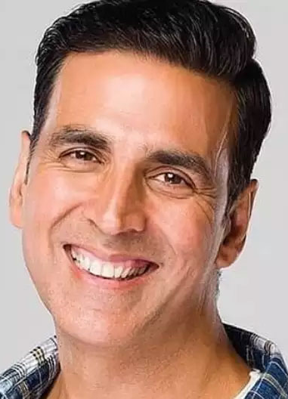
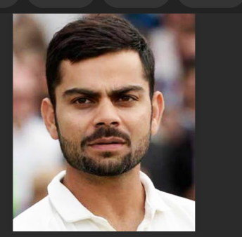
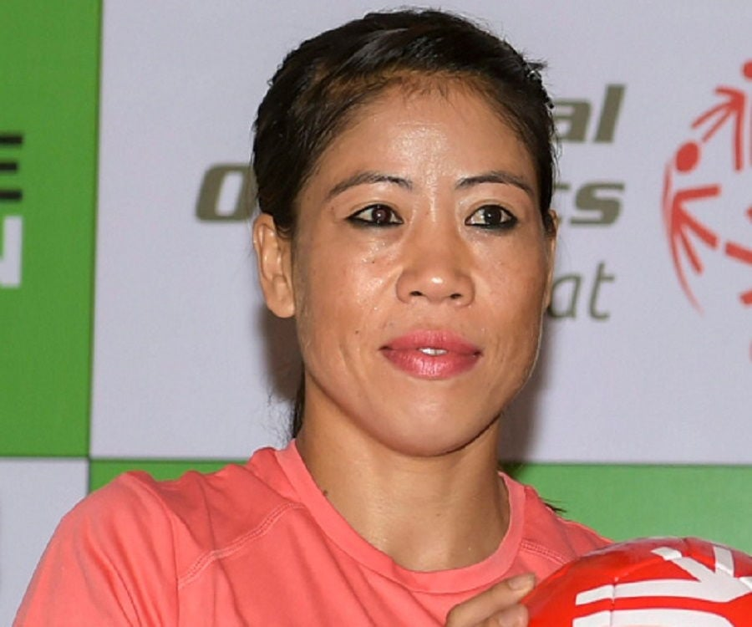

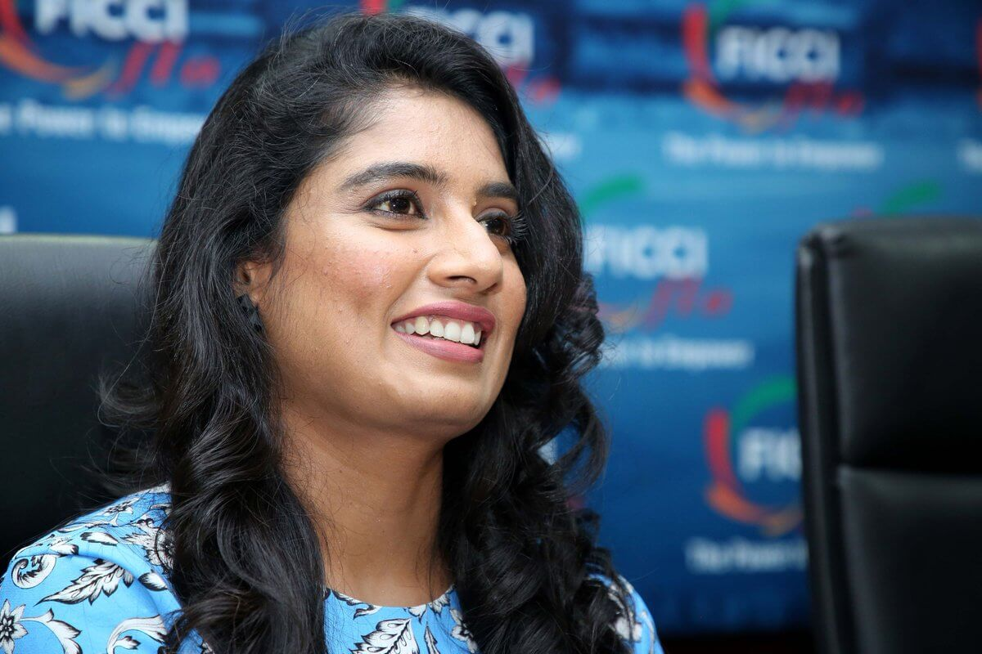
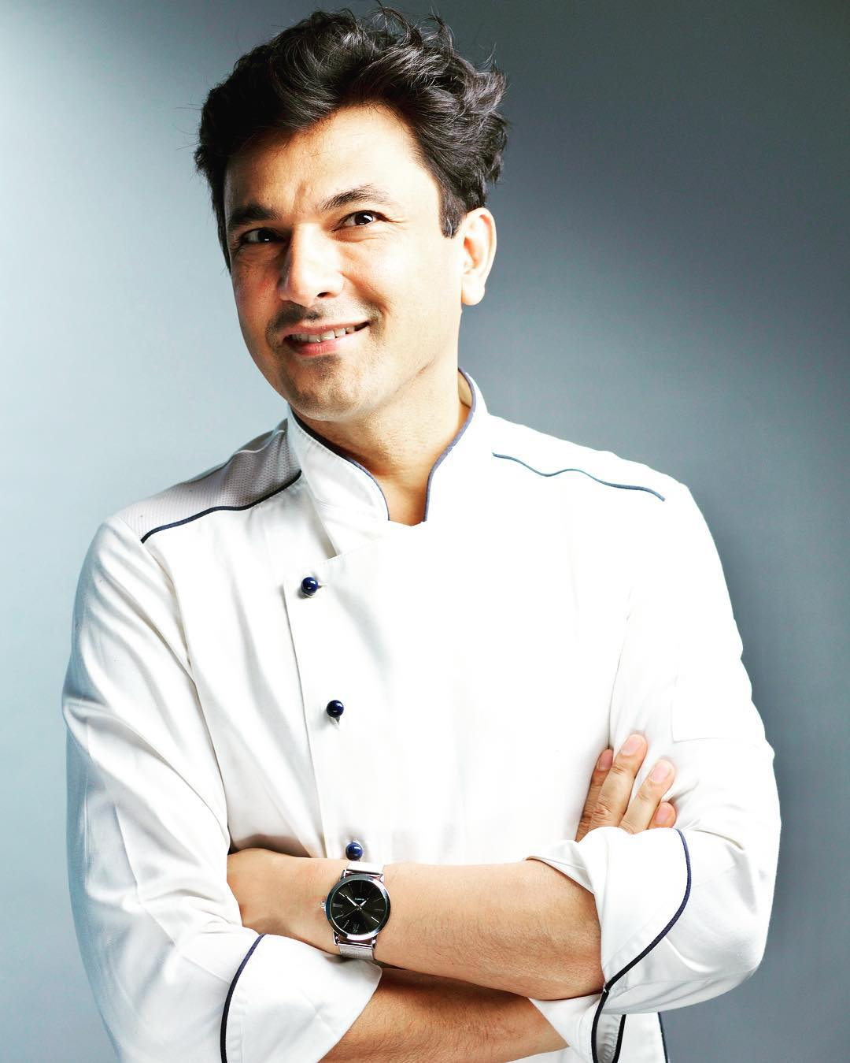
Endorsement Strategy
Attributes of Endorsers
Potential Endorsers
Active lifestyle
Active involvement in sports/exercise
Achiever in their field
Positive Influencer
Followed by a significant proportion of our target customer base

Slide 20
Launch & Expansion Strategy
Launch in 10 major tier 1 cities
Expand to 10 tier 2 cities
Present in more than 50 cities including all state capitals
Launch in 5 tier 1 and 5 tier 2 cities
Launch
Q2
Q3
Q4

Slide 21
Road ahead

Slide 22
Road ahead
Stage 1
Create awareness among people.
Restructure the price.
Bring additional variants with natural ingredients, reduce sugar and add natural sweeteners.
Branding
Stage 2
Advertisements via online and TV commercials.
Execute Stage 1 of launch and meticulously follow the expansion strategy
Positioning the product for a targeted customers
Stage 3
Track sales growth and consumer bran recall every week and month respectively, if needed reassess strategy

Slide 23
Thank you

